Slide 1
Toward an early warning system for SARS-CoV-2 Variants of Concern
Richard H. Scheuermann, PhD
J. Craig Venter Institute
Bacterial and Viral Bioinformatics Resource Center

Slide 2
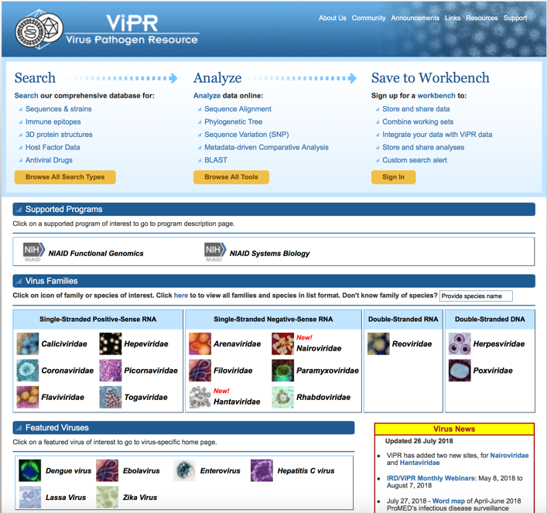
BV-BRC Virus Pathogen Resource (ViPR)
www.viprbrc.org
Comprehensive, integrated database in support of human virus research and surveillance
Free and open access with no restrictions
Focus on data curation, aggregation, integration, and novel data generation
Suite of analysis and visualization microservices using high performance computing (ANL)
Personal workbench areas
~1500 usage sessions/week
Cited in >1300 scientific publications

Slide 3
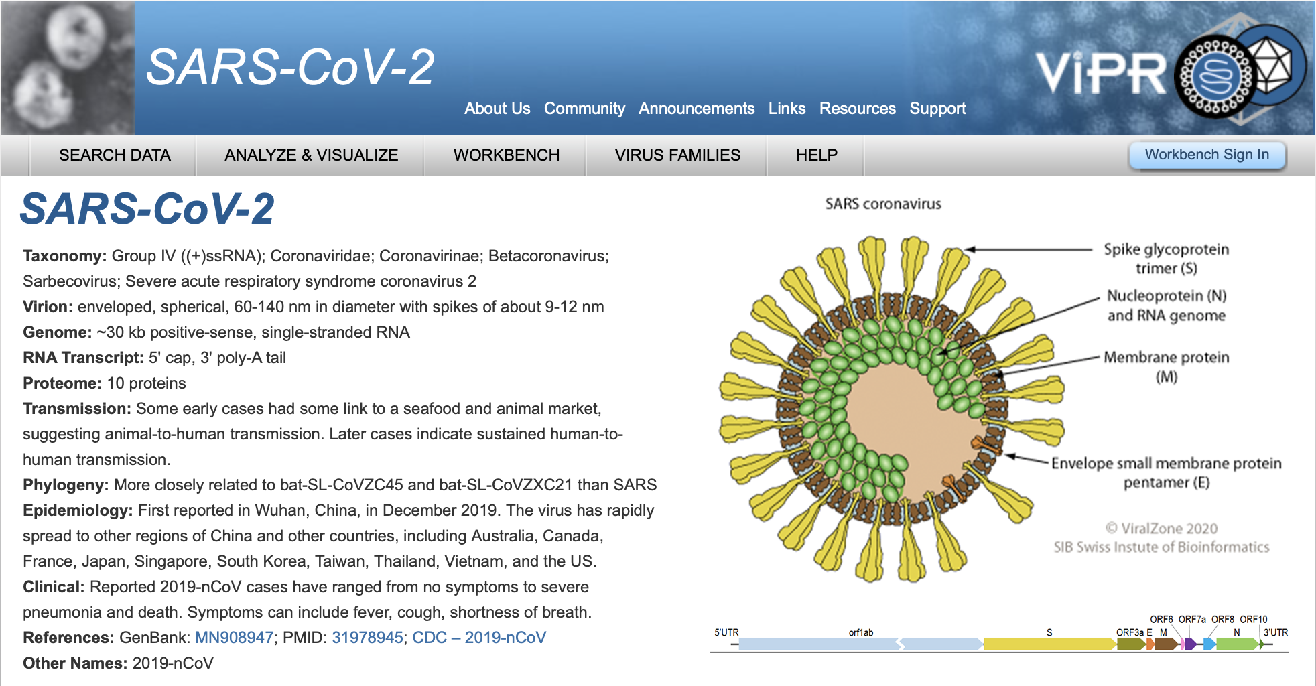
SARS-CoV-2 Featured Virus Portal (FEB2020)
Easy access to all SARS-CoV-2 and other coronavirus genome and protein sequence data, protein structure data, immune epitope data, host response data, protein ortholog predictions, etc.
Customized analysis and visualization tools and services
Linkouts to other resources, including reagents at BEI, epi data at Nextstrain, etc.

Slide 4
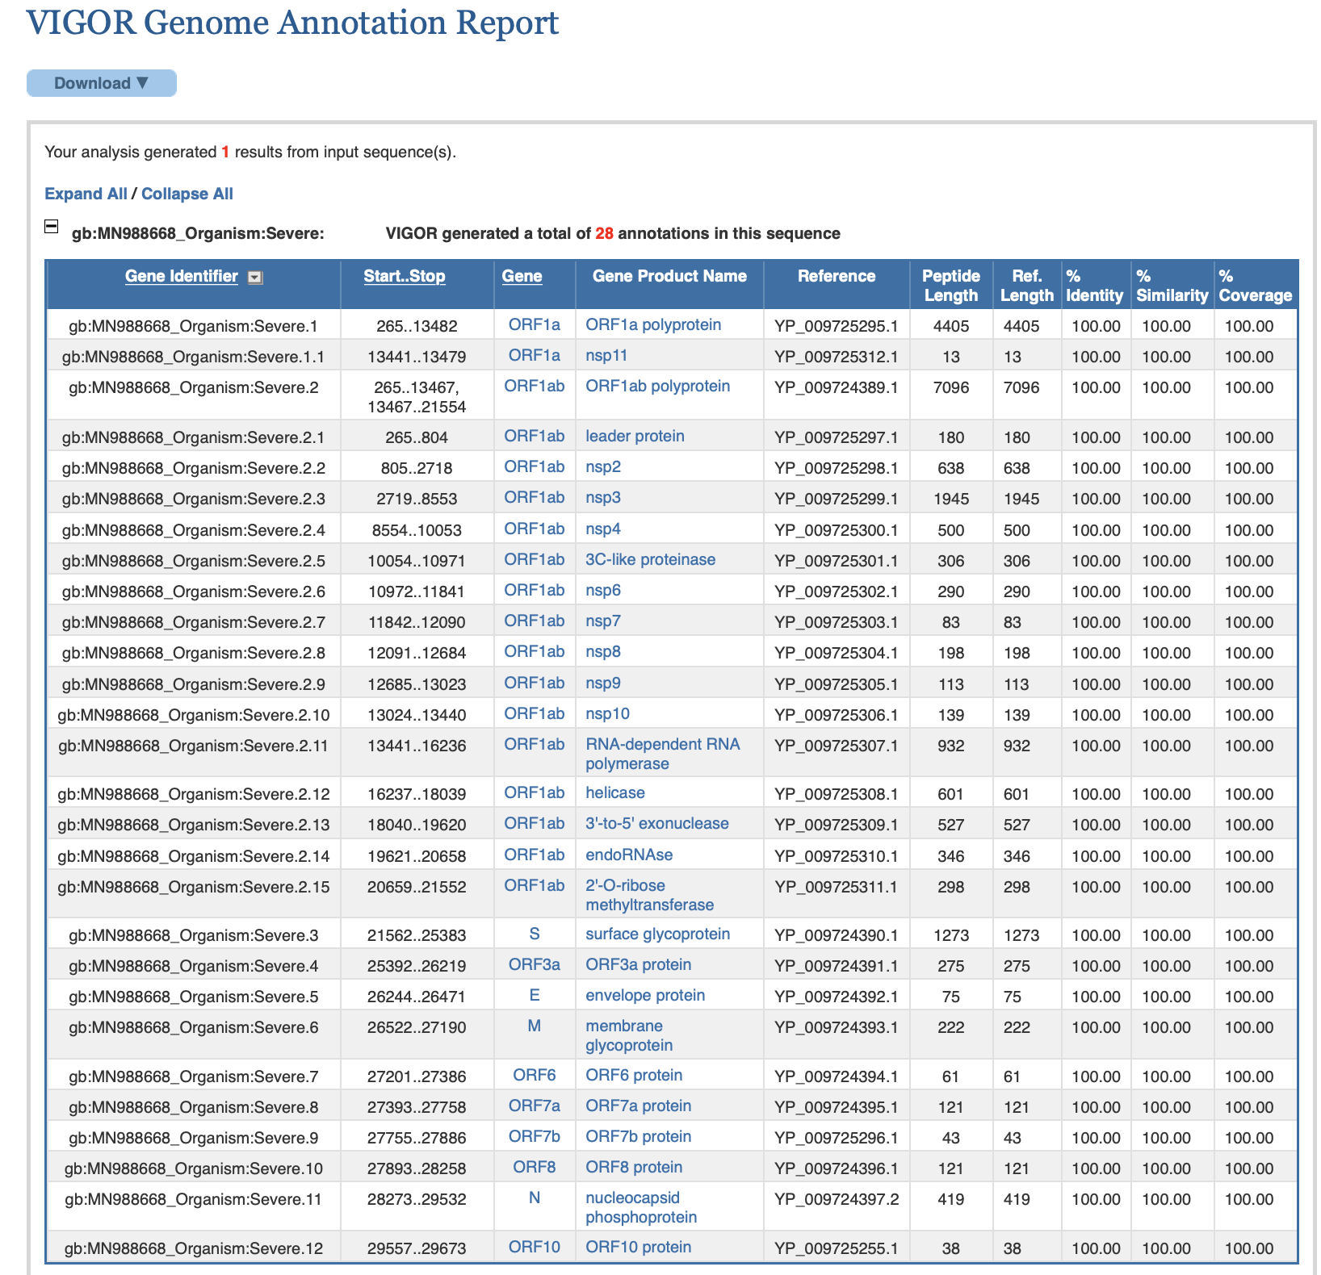
VIGOR4: CoV-2 ORF and Mature Peptide Annotation (APR2020)
Prediction of ribosomal slippage
Orf1a and Orf1ab
Prediction of polyprotein cleavage
Orf1a => nsp1 – 11
Orfab => nsp1 - 16
28 protein ORFs & mature peptides for every full-length genome
Consistent annotations in ViPR DB – >1.3 million protein sequences (FEB2021)
Consistent annotation of user provided sequences

Slide 5
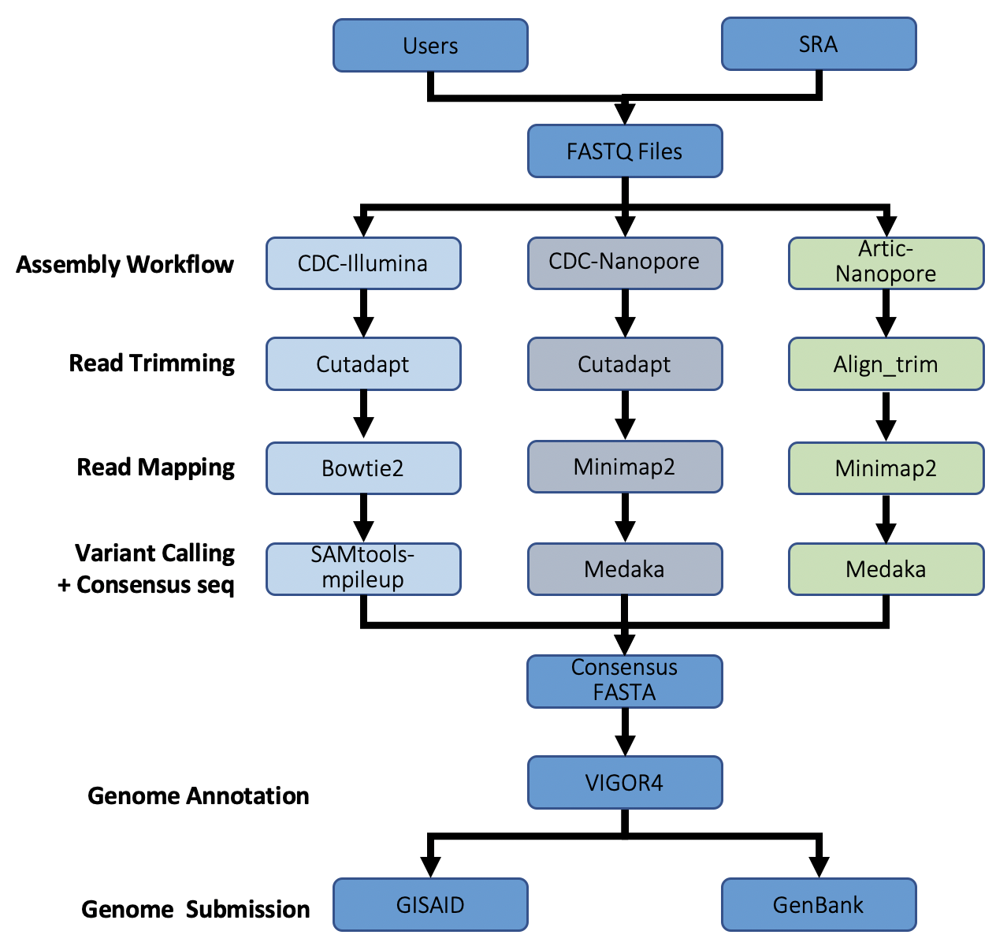
SARS-CoV-2 Genome Assembly and Annotation (JUN2020)
Web-based SARS-CoV-2 genome assembly & annotation service (ANL)
Upload FASTQ files or use SRA accessions
Reference-based assembly using:
CDC-Illumina workflows
CDC-Nanopore workflows
ARTIC-Nanopore workflows
Genome annotation using VIGOR4
Summary report
Download files in various formats for submission or use by other tools

Slide 6
Coronaviridae protein ortholog groups (coming soon)
Collection of all protein orthologs across all human and animal coronaviruses
Analyze taxonomic distribution and and distinct domain architectures
Consistent naming of protein orthologs across Coronaviridae family

Slide 7
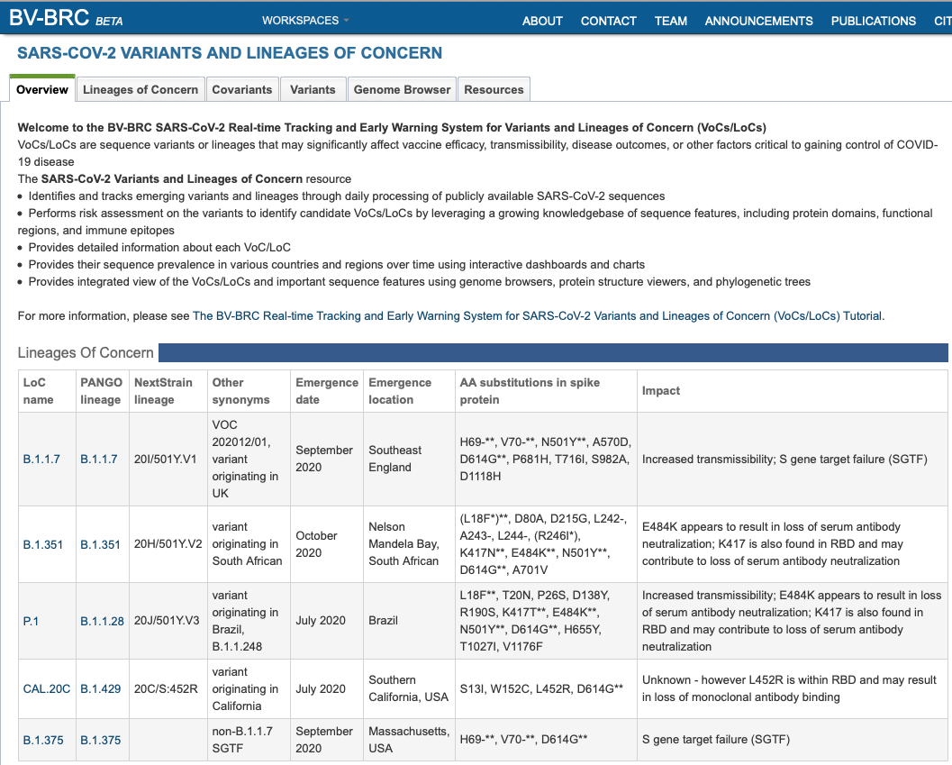
Detection and tracking system for Variants of Concern (VoC) (FEB2021)
Collect and curate information about VoCs and LoCs
Track sequences with already defined defined VoCs and LoCs
Assess newly emerging variants to predict their affects on important virus characteristics

Slide 8
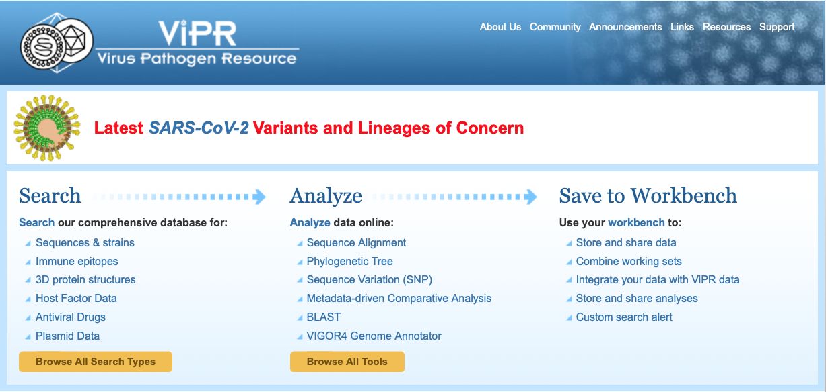
Banner on ViPR home page
www.viprbrc.org

Slide 9
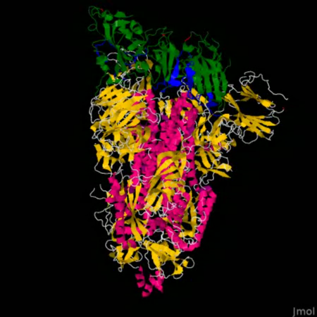
Planned VoC enhancements
Genome browser tracks with experimental data, e.g., Bloom’s mutagenesis/Ab binding data
Structure viewer with sequence feature highlighting
Phylogenetic tree viewer with variant tracking
Track more lineages as they arise
Implementation of an early warning system to identify novel VoCs

Slide 10
VoC Early Warning System
Yellow – Any new missense, frameshift or nonsense mutation that has not been observed previously (these mutations will be assessed for overlap with sequence features of concern (SFoCs)* and will be monitored for significant changes in frequency over time)
Orange - Any new missense, frameshift or nonsense mutation that has not been observed previously and overlaps with sequence features of concern (SFoCs)* or has significantly** increase in frequency over two consecutive reporting periods in a defined geographic region or has emerged in two or more independent lineages suggesting convergent evolution
Red - Any new missense, frameshift or nonsense mutation that has significant** increase in prevalence over two or more consecutive reporting periods in two or more non-contiguous geographic regions or has been demonstrated to increase transmissibility, virulence or immune evasion in a validated experimental system
*SFoCs are defined as “regions of interest” (UniProt), “active sites” (UniProt), “Ab epitopes” (IEDB) “mutagenesis sites” (UniProt), and “LoC markers” (BV-BRC)

Slide 11





Rick Stevens, PI
Thomas Brettin
Neal Conrad
James Davis
Emily Dietrich
Marcus Nguyen
Daniel Murphy-Olson
Robert Olson
Ross Overbeek
Bruce Parrello
Maulik Shukla
Chris Thomas
Harry Yoo
Richard Scheuermann, PI
Brian Aevermann
James Christensen
Jian Lu
Anna Niewiadomska
Indresh Singh
Lucy Stewart
Gene Tan
Zachary Wallace
Yun Zhang
Christian Zmasek
Clark Cucinell
Allan Dickerman
Ron Kenyon
Chunhong Mao
Dustin Machi
Andrew Warren
Rebecca Wattam
Dawen Xie
Fellowship for Interpretation of Genomes
Veronika Vonstein
Philippe Chlenski
Irina Goltsman
Gordon Pusch
Margo VanOeffelen

